Slide 1

AGIP VENTURES
SALES PERFORMANCE ANALYSIS RESULT
NOVEMBER 2021 – NOVEMBER 2024

Slide 2
Problem Statement
As a result of a recent leadership transition, AGIP ventures is undergoing a strategic transition. The new stakeholders have identified three key challenges and opportunities requiring immediate action:
limited market presence
uneven workforce performance
lack of product diversification.
To address these issues, the company aims to expand into new locations, promote high-performing employees, phase out underperformers, and introduce innovative products to meet evolving market demands.

Slide 3
ACTIONS
New branches can be opened in other states and geographical locations.
Efficient sales rep like Olamide Ifeyinwa should be rewarded and their proven strategies should be emulated.

Slide 4
OBJECTIVES
Analyze the demographics of AGIP ventures customers.
Examine the total sales by product.
Evaluate the efficiency of the sales representatives.
Compare locations and the revenue generated.
Examine the return rate of each product.
Analyze the sales pattern over the years.

Slide 5
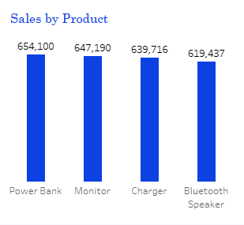
FACTS
Power bank has the highest sales
Bluetooth speaker has the lowest sales

Slide 6
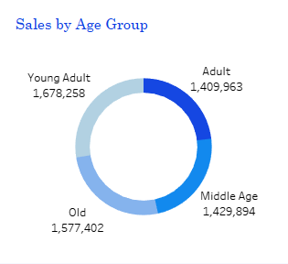
Facts
Young adult purchased the highest amount of items
Adults purchased the least amount of items

Slide 7
Insights
After a thorough analysis of the sales by each age group, it is observed that AGIP ventures product is used by all but mostly the young adults.

Slide 8
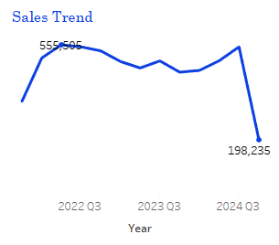
Insights
There was a major dip in sales in the most current year, 2024 and the maximum amount of sales was recorded in an earlier year 2022, indicative that the brand of the products are not in line with the current trends. They could be older versions.

Slide 9
INSIGHTS
Evaluation of the return rate by year shows that 2021 had the lowest return rate, a further indication that the brands of electronics and accessories are older.

Slide 10
Recommendations
New branches can be opened in other states and geopolitical locations since there are good sales in the existing locations.

Slide 11
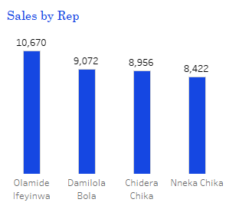
Recommendations
High performing sales rep like Olamide Ifeyinwa, Damilola Bola, Chidera Chika and Nneka Chika should be rewarded encouraged to share their proven strategies with other sales rep.

Slide 12
Recommendations
Newer brands of electronics and accessories should be ventured into to augment the total sales.
Other highly purchased electronics and accessories should be explored since all the products are well purchased

Slide 13
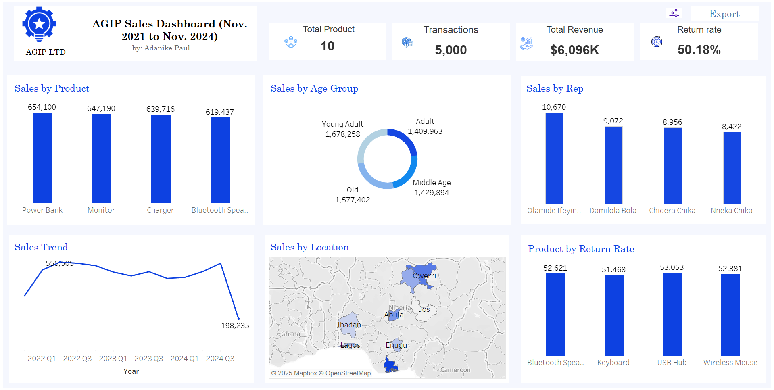

Slide 14
Thank you
ADANIKE PAUL
08105611178
paultheanalyst1@gmail.com

